Slide 1
Binary search tree
It-1911
Bigabulova dariya , adil akniet

Slide 2
Introduction
Binary Search Tree, is a node-based binary tree data structure which has the following properties:
The left subtree of a node contains only nodes with keys lesser than the node’s key.
The right subtree of a node contains only nodes with keys greater than the node’s key.
The left and right subtree each must also be a binary search tree.
There must be no duplicate nodes.

Slide 3
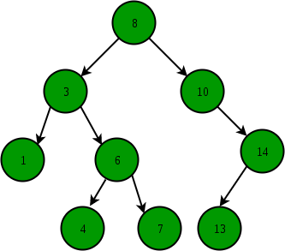
Introduction

Slide 4
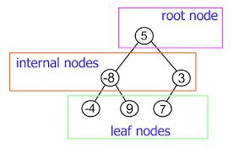
Trees

Slide 5
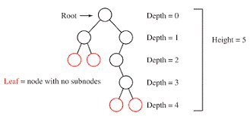
Height

Slide 6
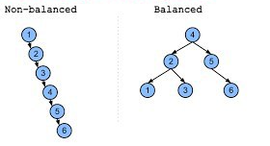
Balanced binary tree

Slide 7
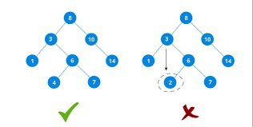
Binary Search Tree(BST)

Slide 8
Operations
The main operations in binary tree are: search, insert and delete.
pros:
Get rid of half of the data in which we are searching time complexety O(log n)

Slide 9
Operations
insert(build)
serch(min/max):
using: if/else and recursion
delete
leaf node(no child)
single child
2 child:
predecessor
successor(with swap)
traverse(show):
in-order
pre-order
post-order

Slide 10
Tree Traversal
•Traversing a tree means visiting each node in a specified order
• This process is not as commonly used as finding, inserting, and deleting nodes. One reason for this is that traversal is not particularly fast.
•There are generally two types of traversal: − breadth first − depth first.
•There are three variants for depth first traverse a tree. They're called preorder, inorder, and postorder.

Slide 11
Inorder Traversal
• An in-order traversal of a binary search tree will cause all the nodes to be visited in ascending order, based on their key values. If you want to create a sorted list of the data in a binary tree, this is one way to do it.
• The simplest way to carry out a traversal is the use of recursion . A recursive method to traverse the entire tree is called with a node as an argument. Initially, this node is the root. The method needs to do only three things:
Call itself to traverse the node's left subtree
Visit the node
Call itself to traverse the node's right subtree

Slide 12
code
private void inOrder(Node *localRoot)
{
if(localRoot != NULL) {
inOrder(localRoot->leftChild);
localRoot->displayNode();
inOrder(localRoot->rightChild);
}
}

Slide 13
example
Answer:1,3,4,6,7,8,10,14

